Slide 1
Graph Capabilities in SQL Server 2017+
Joubin Najmaie
O# Team Night
November 2018

Slide 2
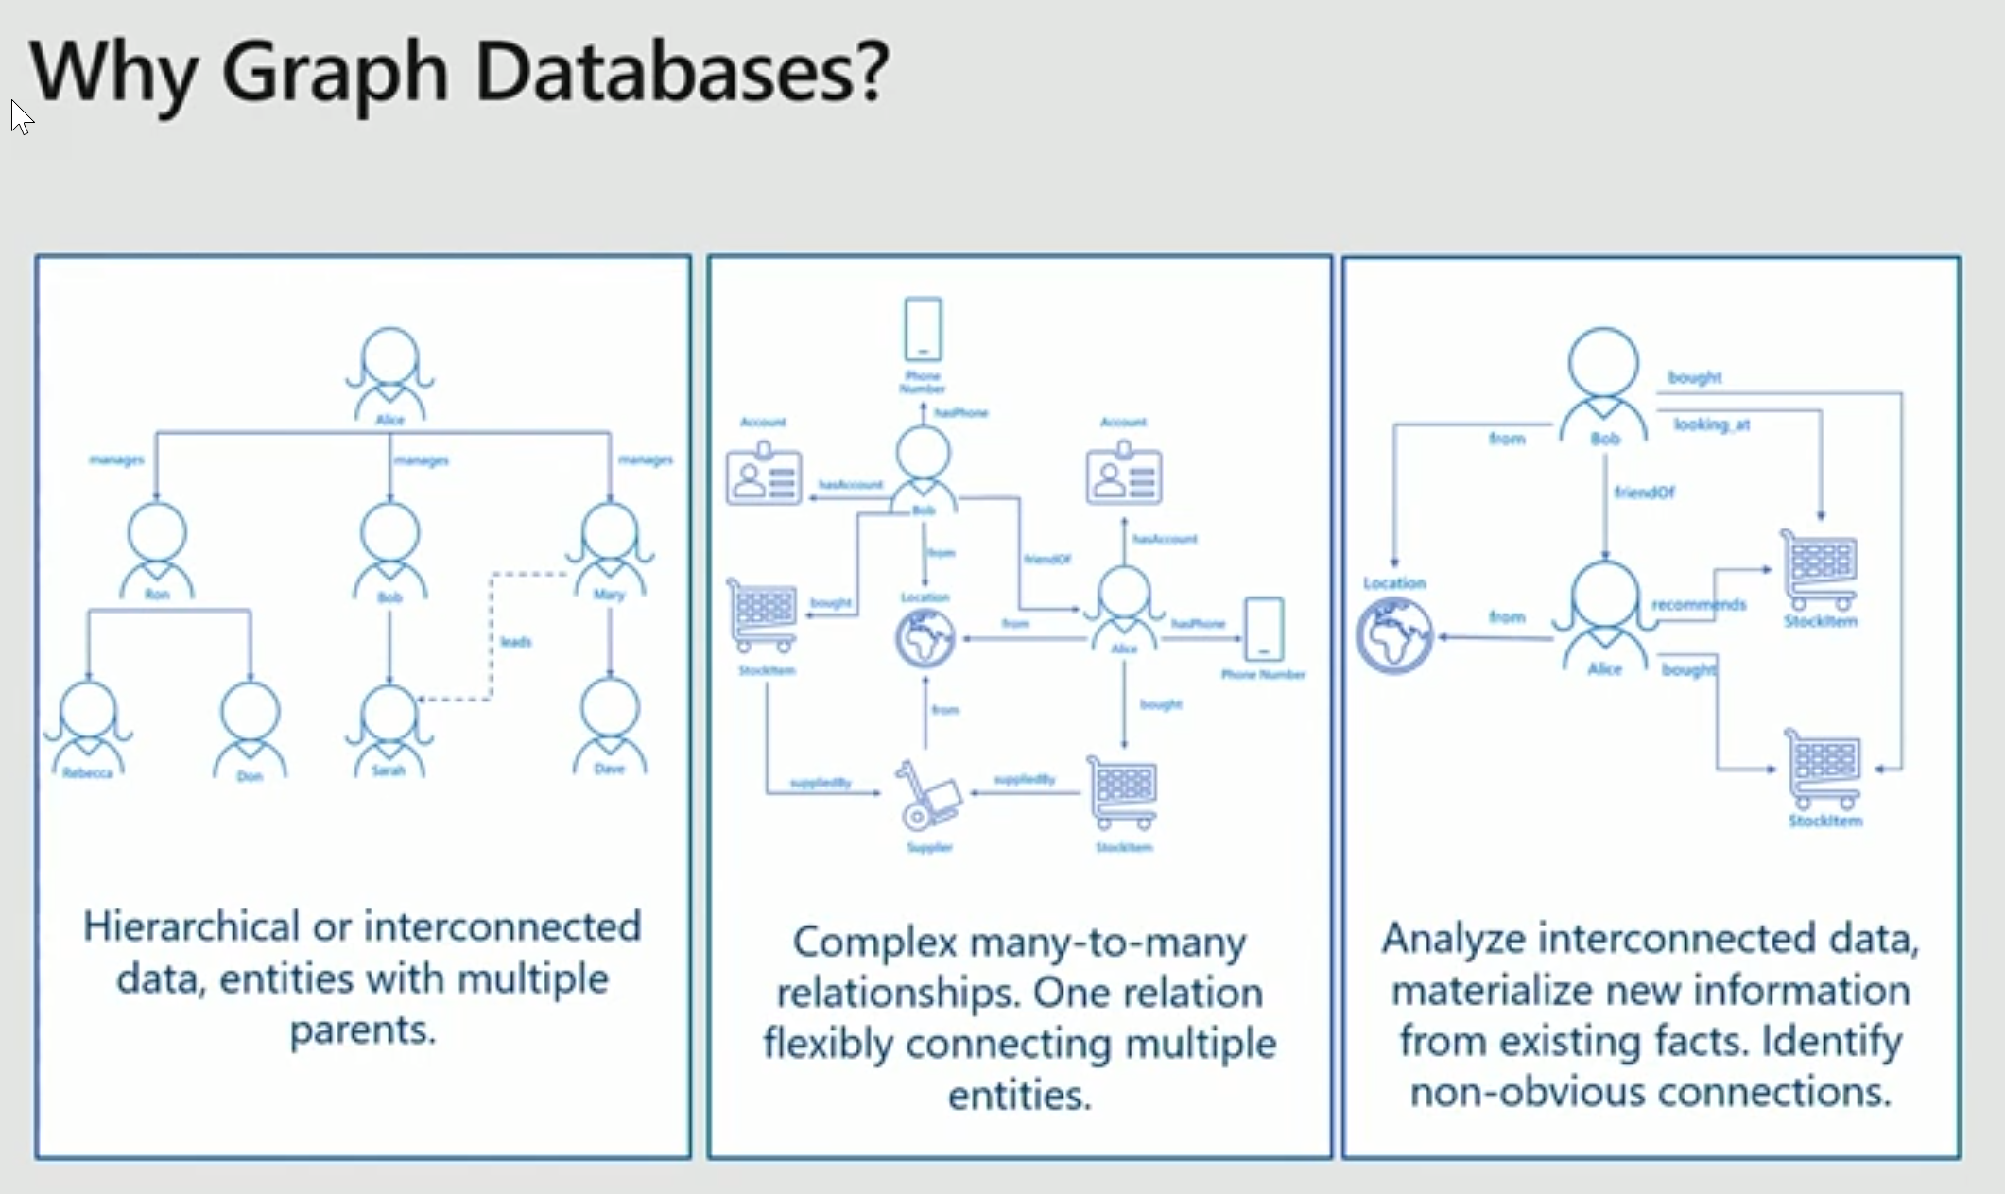

Slide 3
Graph capability?
Nodes & directional Edges
Example:
author (node)
posts (edge)
article (node)

Slide 4
First class entities
An edge entity can connect multiple nodes
constraints
Pattern matching and multi-hop navigation queries more easily
Embrace and extend approach
Supports OLTP and OLAP just like a relational entities
You can mix relational and graph database entities

Slide 5
SQL Extensions in 2017, but native to 2019
SQL Server 2017 – Graph Extensions
Graph schema
Nodes and Edges are represented as tables
Mix relational and graph schemas
DDL Extensions
To create nodes and edges
Query Language Extensions
MATCH to support pattern matching and traversal
ASCII-art syntax

